Slide 1
Intro to Rocketry

Slide 2
What is a rocket?
According to NASA, a rocket is “A vehicle, typically cylindrical, containing liquid or solid propellants which produce hot gases or ions that are ejected rearward through a nozzle.”
Notes:
Have the kids answer the question first
What is difference between rocket and airplane?

Slide 3
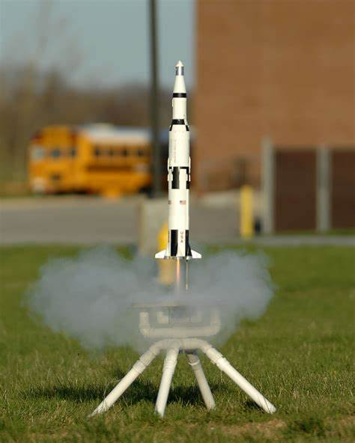
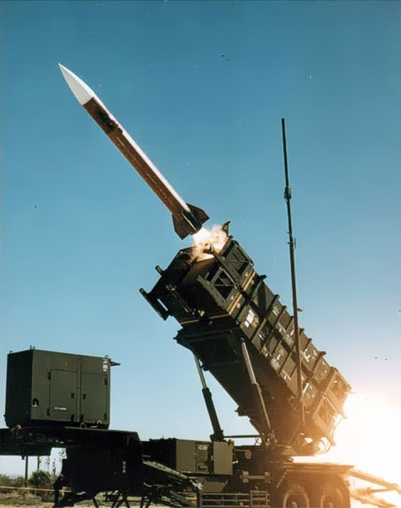
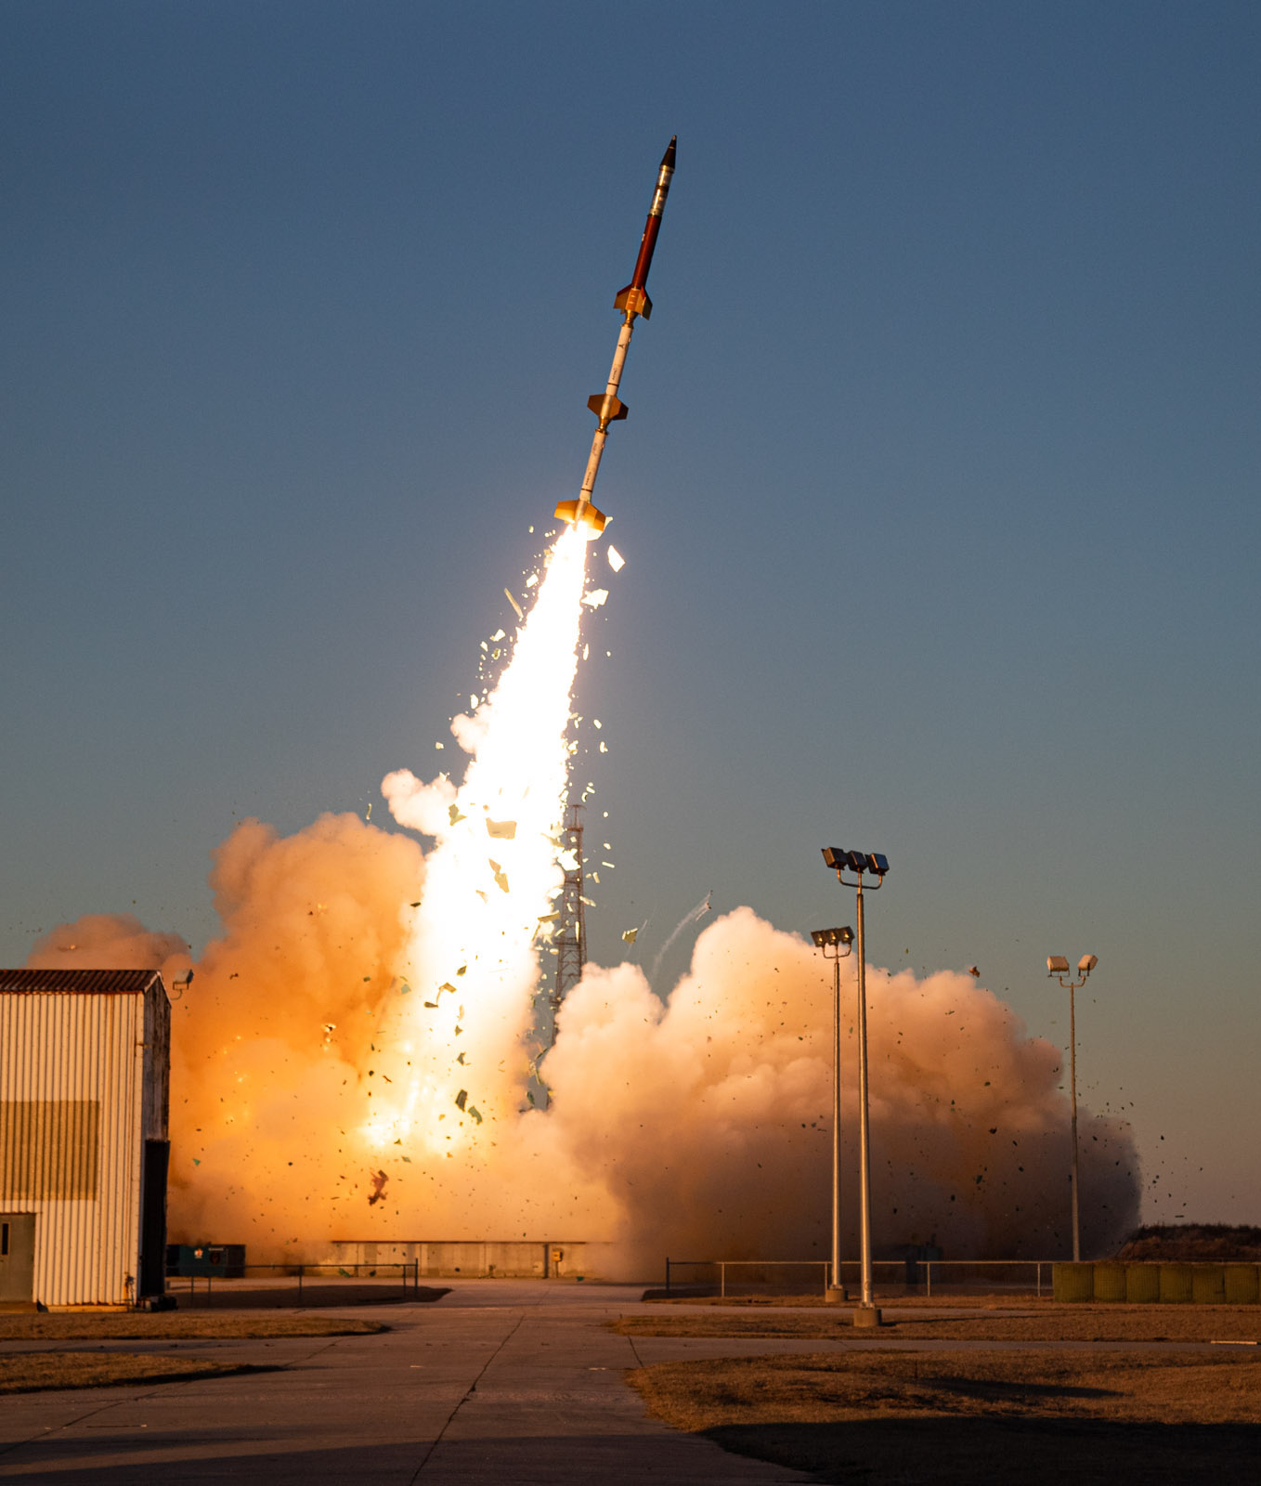
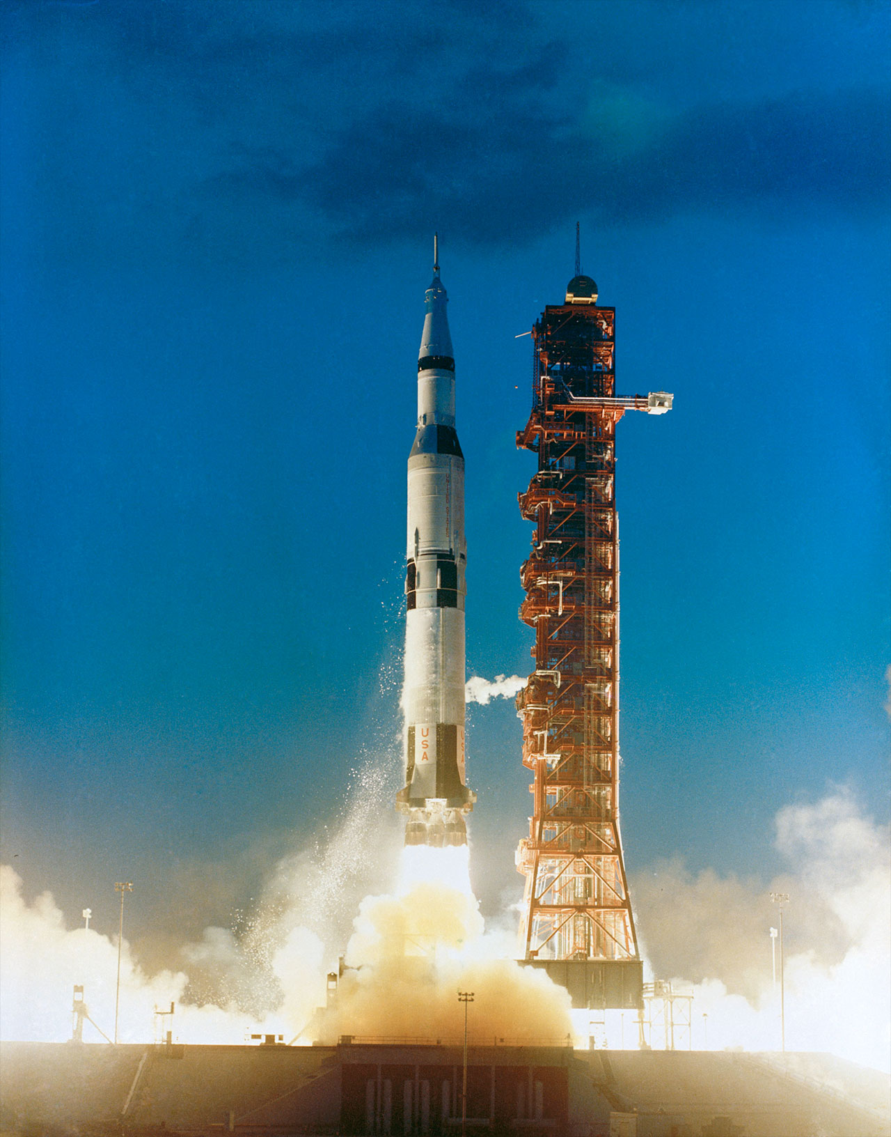
Uses of Rocketry
Hobby
Missles
Sounding Rockets
Launch Vehicles
Notes:
Sounding rockets – Rockets carrying scientific instruments into the upper atmosphere to take measurements of things like air quality and radiation in the air

Slide 4
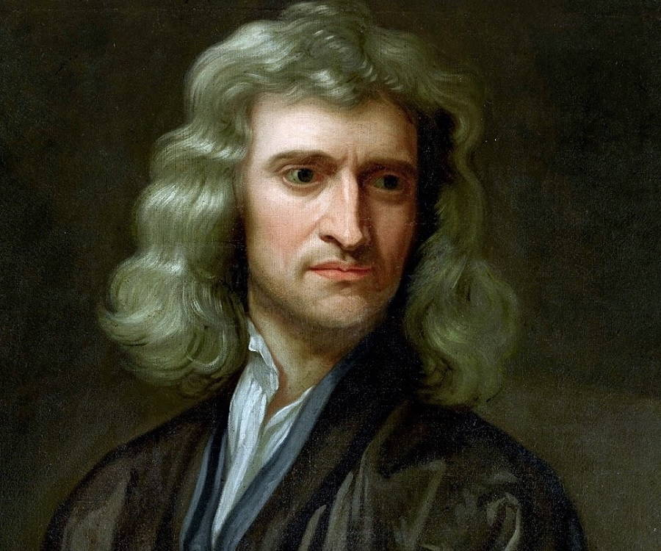
Newton’s Laws of Motion
An object at rest or at constant velocity will remain so until acted upon by an external force. (Law of inertia)
The net force on an object equals the force applied times its acceleration. (F = ma)
For every action, there is an equal and opposite reaction.
Notes:
How do these three laws relate to rocketry?

Slide 5
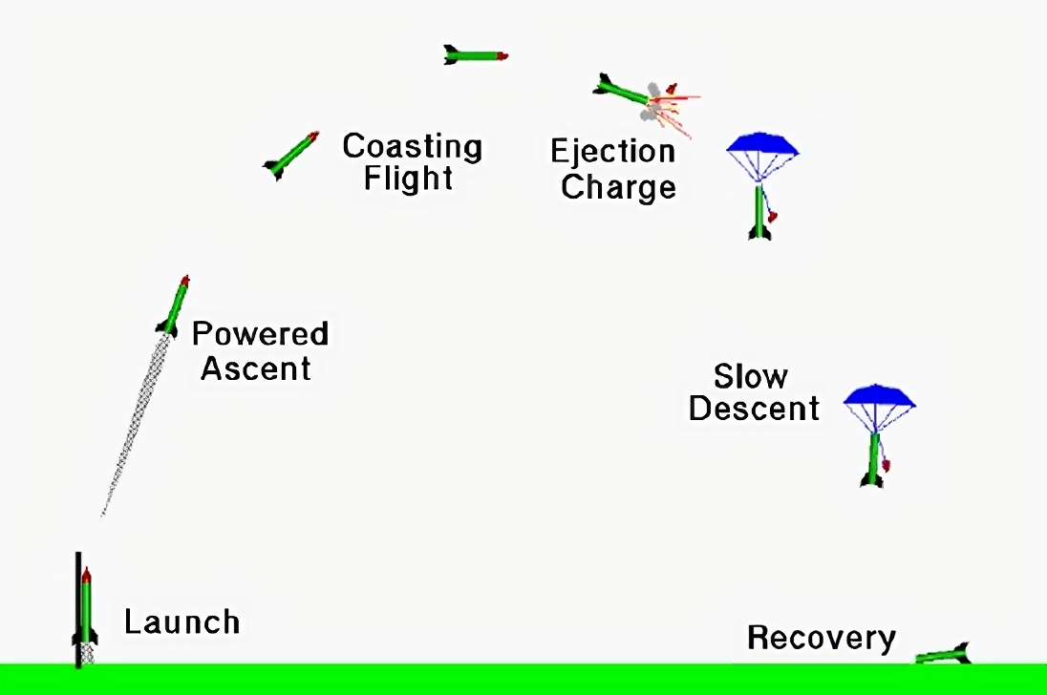
Flight of a Model Rocket
Notes:
Talk about velocity and acceleration at each point

Slide 6
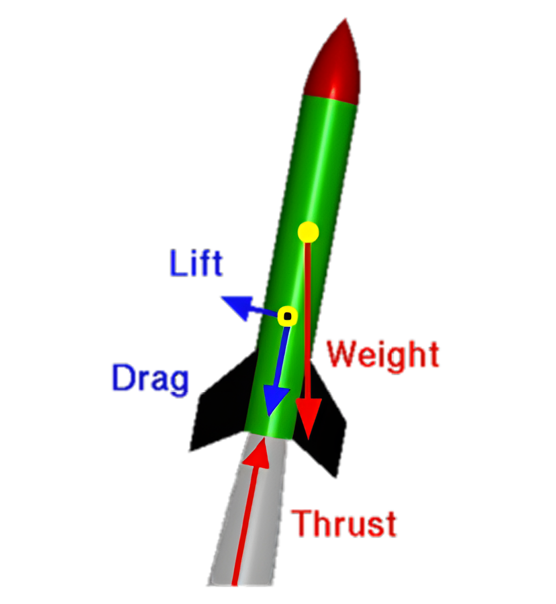
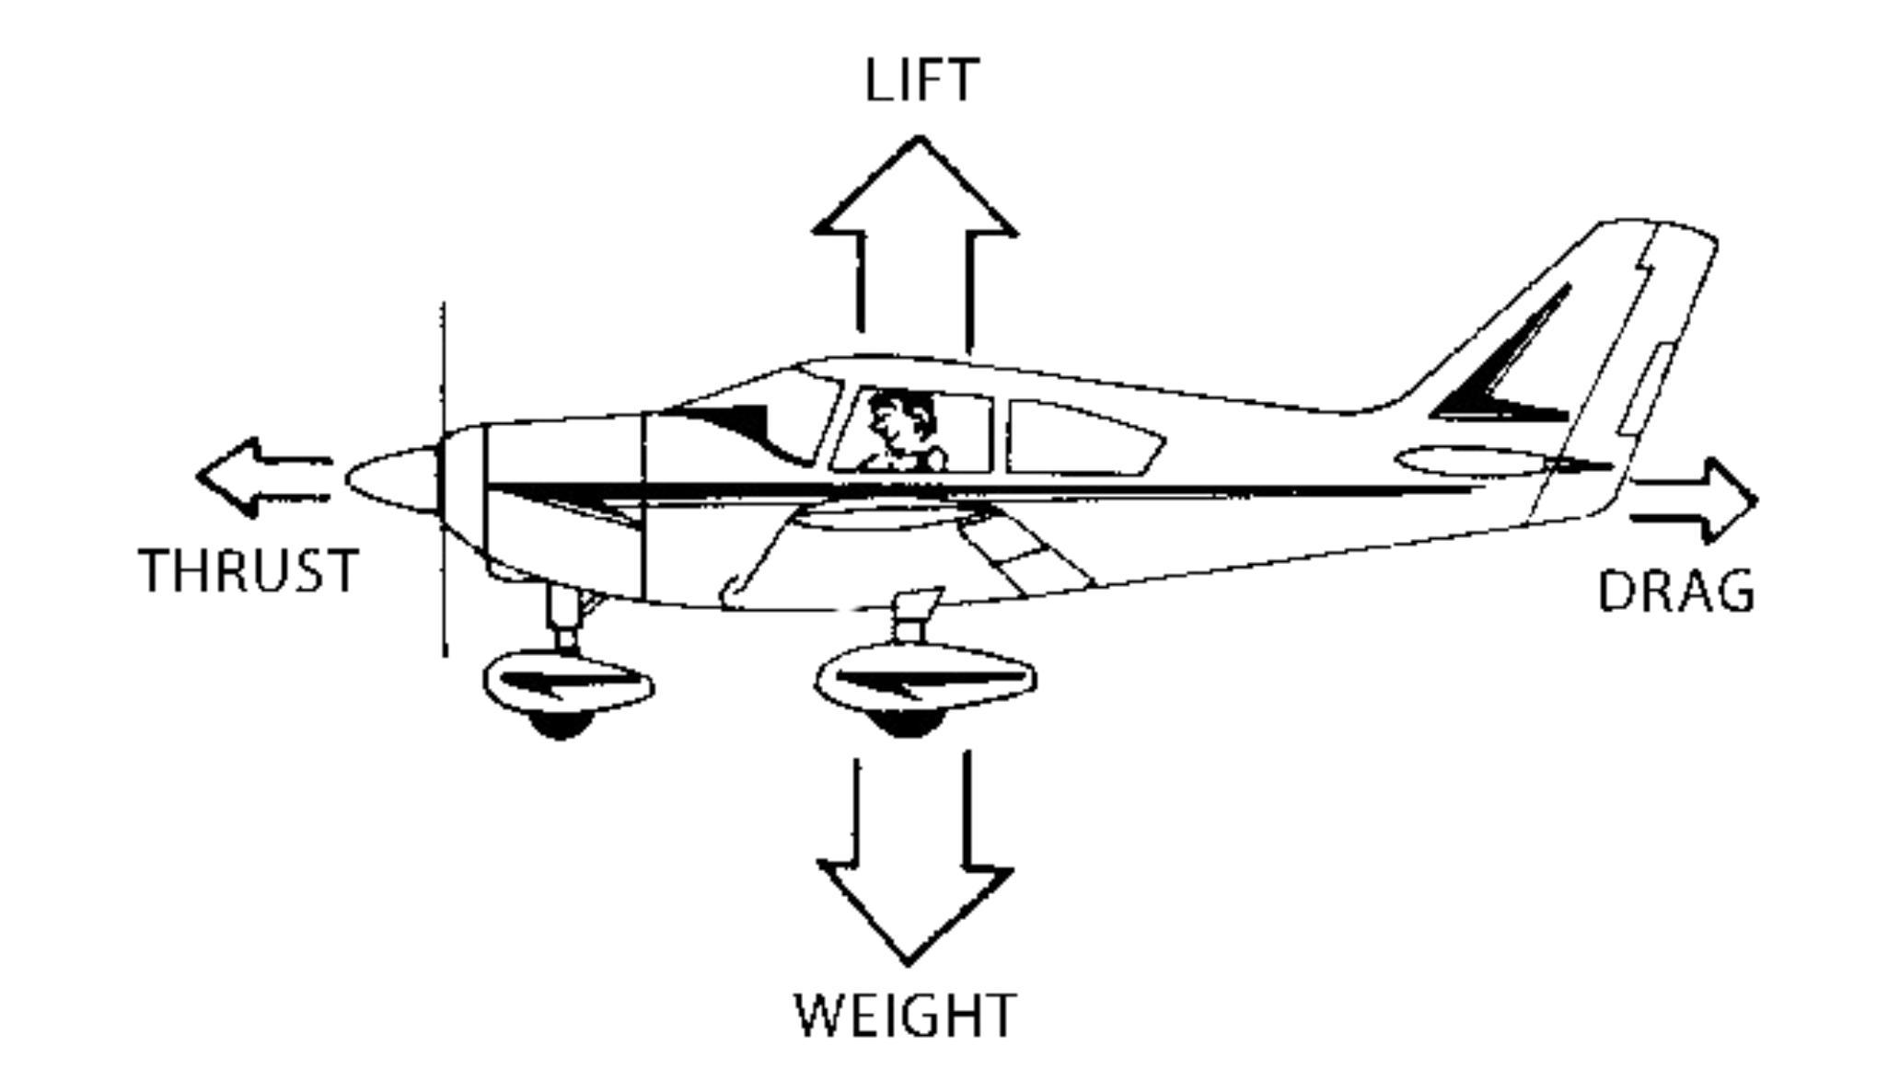
Forces on an Airplane vs Rocket
Notes:
Drag – depends on surface area
Lift – less relevant on rockets, but is due to fins – caused by angle of attack

Slide 7
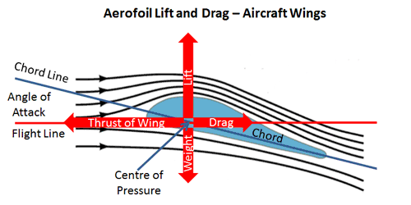
Lift Force
Notes:
Drag – depends on surface area
Lift – Instead of wings, rockets have fins, and fins also generate lift – it’s what causes rockets to right themselves, since lift only occurs when there is an angle of attack

Slide 8
Aerodynamics of Flight
The Object:
Shape
Size
The Motion:
Velocity
Angle to airflow
The Air:
Viscosity
Density
Compressibility
Notes:
Things that affect viscosity: temperature and pressure
Air is more compressible at low speeds and less compressible at high speeds because the particles don’t have time to get out of the way

Slide 9
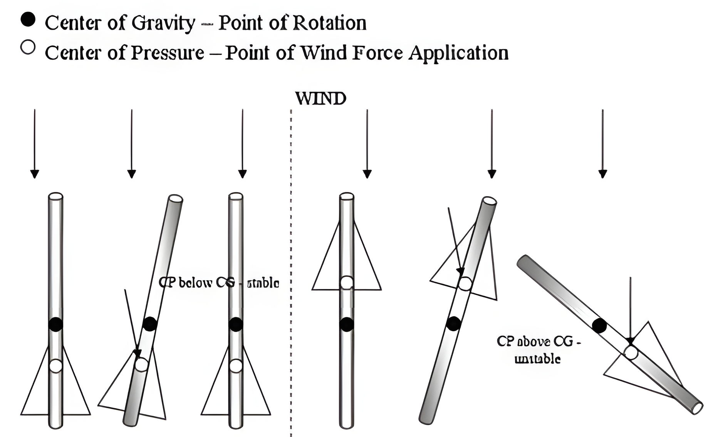
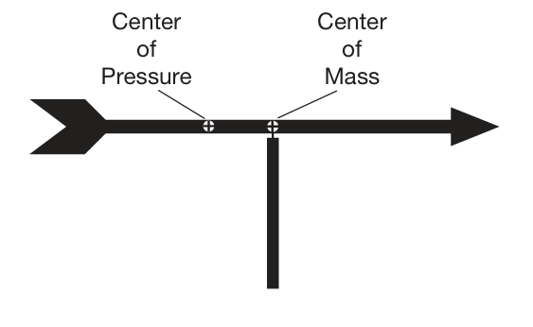
Rocket Stability
Notes:
Spin stabilization too
CP = average surface area point
The most important thing to consider when building a model rocket is CG vs CP ratio. Less important in actual rockets because of active control. Some missiles purposely have a low stability so that they can maneuver better, since there is less resistance to change.

Slide 10
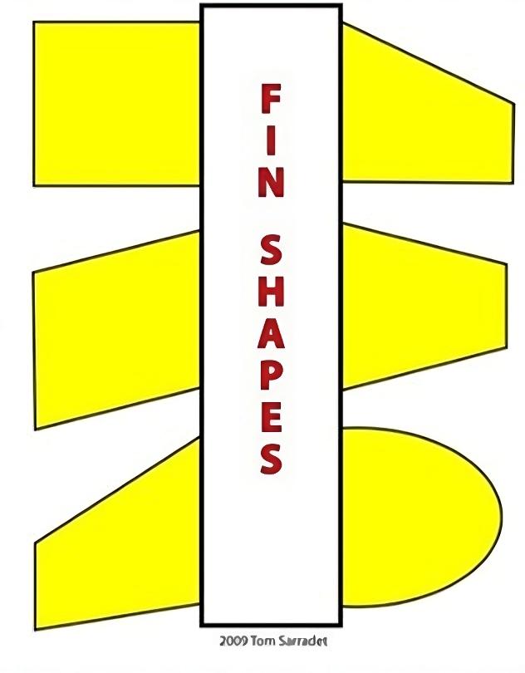

Fin Shapes
Rectangular
Clipped Delta
Trapezoidal
Swept
Tapered Swept
Elliptical
Notes:
Elliptical – most aerodynamic, but difficult to construct
Trapezoidal – moves CP forward
Rectangular/square – easiest to make, but least aerodynamic
Clipped delta – aerodynamic, moderately easy to construct, very well balanced
Also swept type – more aerodynamic and moves CP back

